Slide 1
Order your jacket tutorial
BT Sales

Slide 2
This presentation will assist in ordering your students Letterman Jacket
We will explain the form
Show you the items that can be purchased for your jacket
Present each section of the form
Display a sample of each section completed
Have a copy of your form available as you view the tutorial
Most important we are an e-mail or call away to assist you.

Slide 3
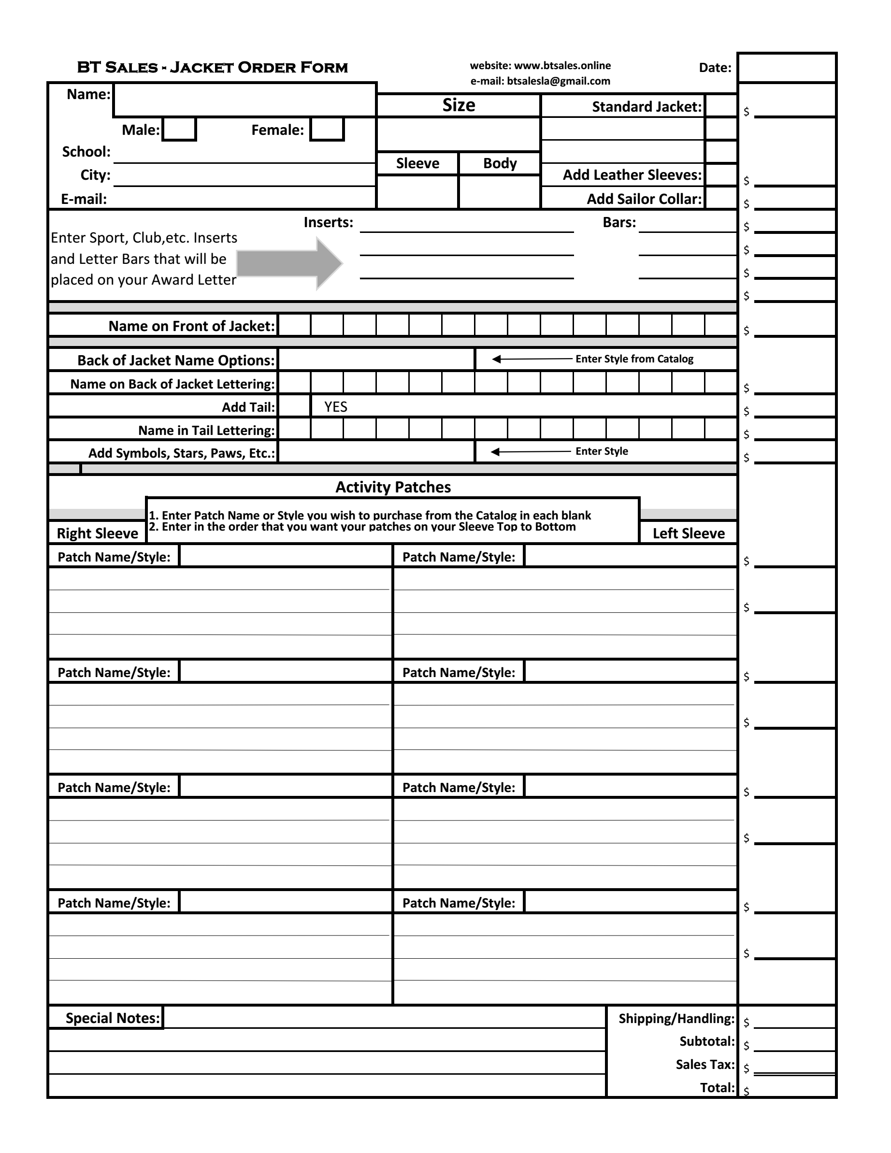
Lets start with your form
On the next few pages we will take sections of your form and display examples of how to complete
Pictures of a Standard Jacket will be included
Please have a copy of your form in front of you

Slide 4
Starting at the Top
Enter Student’s Name
Place an “X” in the proper Gender
Enter School or Organization
Enter City
Enter a valid e-mail address
Your Sales Rep will fill
out this portion of your form
2. Sizes are suggested to each student, but the final decision is the responsibility of the student and/or parent
1. Place an “X” in the Standard
jacket box
2. Each School has a standard
specification written
3. Place an “X” to add upgrades
such as a Sailor Collar or Leather
sleeves

Slide 5
Example of completed Info Section

Slide 6
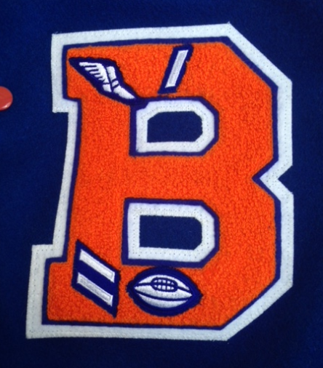
Award Letter
On the insert lines above enter the sport or
club symbol that your student participated or
qualified in per school requirements. For
example the picture to the left is a Track Shoe
and One Letter bar and Football with Two Letter Bars.
Other examples:
Music Notes
Clubs ( BETA, DECA, etc.)
Academic Lamp
All Sports
Just ask and we will let you know if we can add

Slide 7
Example of completed Award Letter Section
This is how you would complete this section using the example to
the left. A Football insert and 2 bars if your student lettered for
two years of Varsity Football. And a Track shoe with one bar for one
year of Varsity Track.
Inserts can be specific to Sports, Music, Clubs, etc.

Slide 8
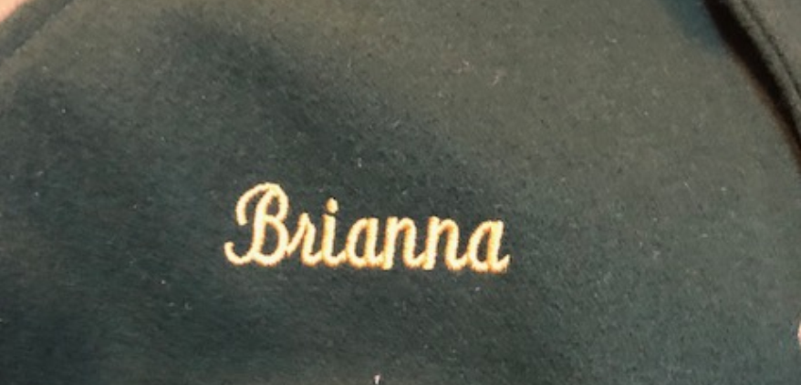
Name on Front
This is 1 inch embroidered lettering on the right chest of the jacket.
An example is the picture to the left.
Sample of completed section below

Slide 9
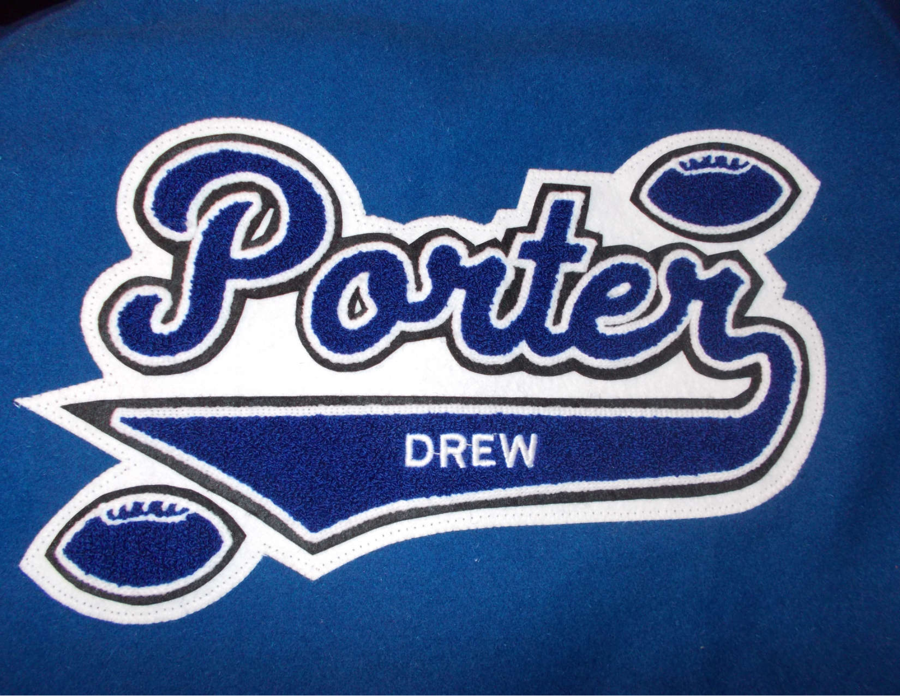
Name on Back Section
In this section you can order a chenille patch with your name
and many added options. The example to the left is a students
name in “Script” style with a tail added. Additional options the
Student added lettering in the tail and Football Symbols. Please
view our brochure online or in your student package for the
styles available.
See the next page for and example.

Slide 10
Example of completed Name on Back Section
In this section as shown above please choose a style from
our brochure and enter your name. Add options to dress
up your patch is you choose. We can add symbols for sports,
music/band, stars, paws, etc. Just ask.

Slide 11
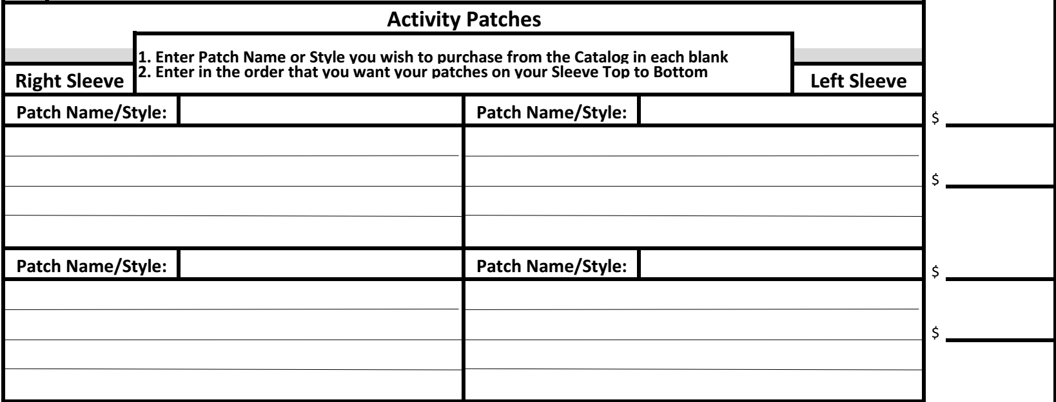
Sleeve Patch Section
In this section of the form you will select the patches that you want on each sleeve of your jacket. On the
next few pages we will show examples of the most common and popular versions placed on student
jackets. This is you jacket and you can design to your needs within school guidelines.

Slide 12
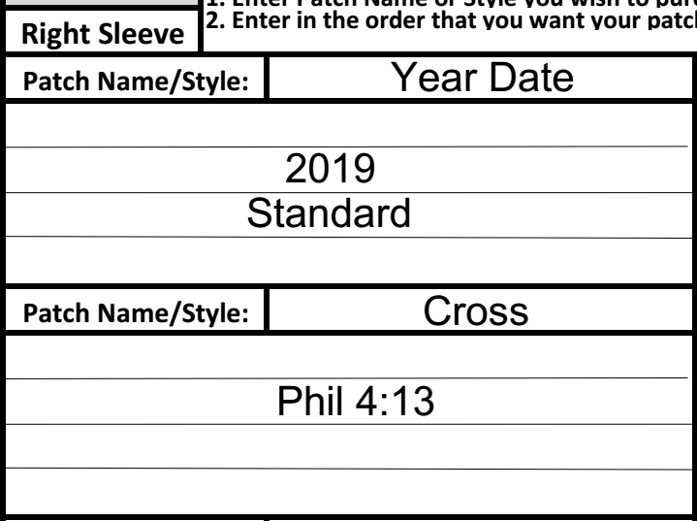
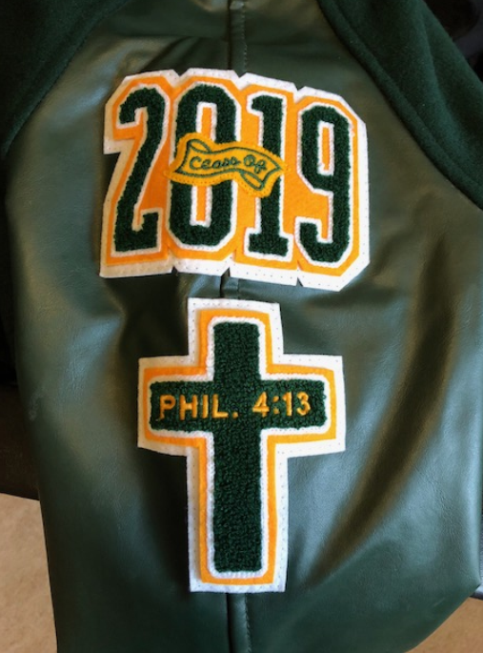
Sleeve Patch Section – Right Sleeve Example
We will show examples of the form and patches for this section. The picture is the right sleeve of a student jacket. It is
standard to put your graduation year on the top of either sleeve. This patch will be on the top of the right sleeve. Below
is a Cross as shown in our brochure with embroidering per the student request. You can fill in blanks for patch #3 and
#4 with any style you choose or are qualified for. As the note on the form states we will place the patches on each sleeve
in the order filled out on the form.

Slide 13
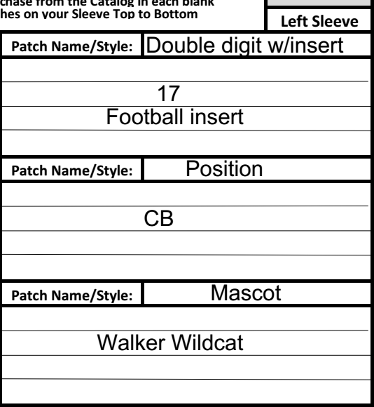
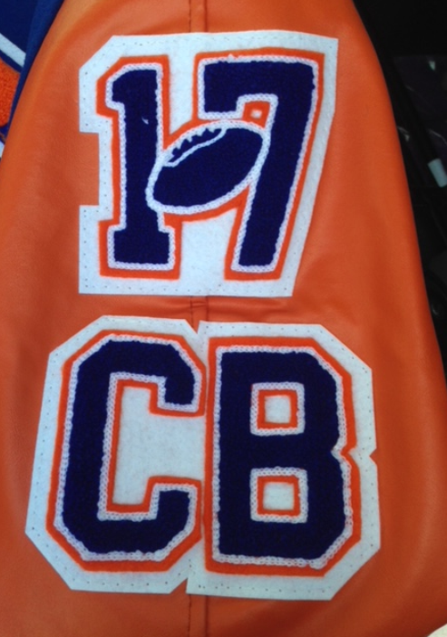
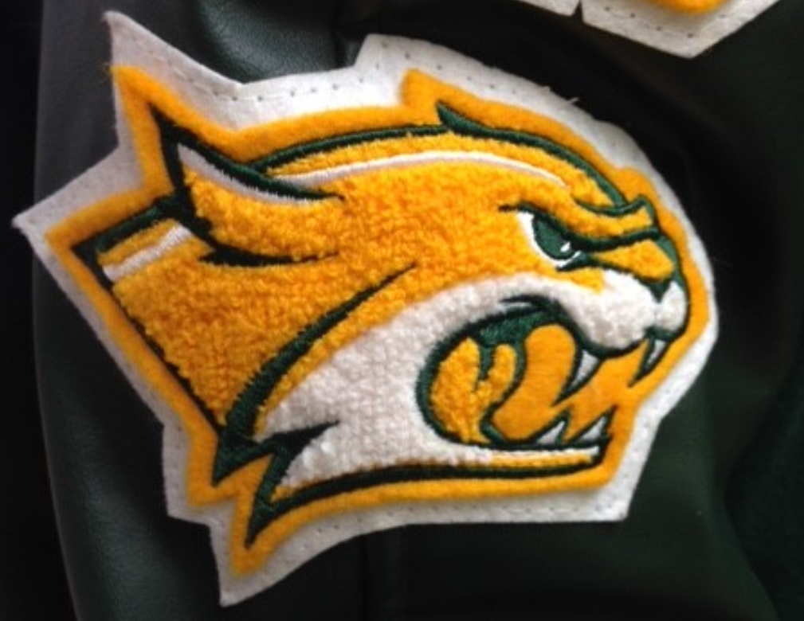
Sleeve Patch Section – Left Sleeve Example
Lets put 3 patches on the left sleeve
starting at the top with a Jersey Number
and a sports insert ( can be any sport just enter ). A position patch, an insert can be added. Last is a school Mascot, so just enter Mascot and we will make sure that the patch we have for your school will be entered properly.

Slide 14
Patch notes:
If a patch in our brochure has blank space we can embroider lettering in that space for you, at no additional charge
We can also replace any lettering you see as examples in our brochure
Most patches in our brochure will come in school colors, but National Organizations and Clubs come in official colors. You have request color schemes different from national schemes.
We are available to assist you with your form. Contact us and we can help via
a phone call. Or, take a picture of the form and text it to us. It will appear in our e-mail. We will fill it out and price for your review.

Slide 15
Online Options
We have online form options available. If you choose that option we will complete the form with pricing and send it back for your review.
Payment Options
We have online payment options available. If you choose that option your student will not have to bring any paperwork or payment to school.
BT Sales
www.btsales.online
E-mail: btsalesla@gmail.com
Contact: (225)244-9259

